Slide 1
AI STUDY BUDDY
CAPSTONE PROJECT
Presented By:
Student Name- NEERAJ
College Name- SRI BALAJI COLLEGE OF ENGINEERING & TECHNOLOGY, JAIPUR
Department- BACHELOR OF TECHNOLOGY IN COMPUTER SCIENCE AND ENGINEERING

Slide 2
OUTLINE
Problem Statement (Should not include solution)
Proposed System/Solution
System Development Approach (Technology Used)
Algorithm & Deployment
Result
Conclusion
Future Scope
References

Slide 3
Problem Statement
Information Overload: College syllabus is huge. Students get very long PDFs and books to read, and extracting important points takes too much time before exams.
Lack of Instant Help: When studying late at night, students cannot ask teachers for help if they don't understand a tough topic.
Coding & Math Struggles: Finding a missing semicolon in programming or solving a multi-step math equation by yourself is very frustrating and time-consuming.
Poor Time Management: Creating a realistic study timetable that covers all syllabus topics in the remaining days is confusing, so students often skip planning.
Expensive Tutors: Hiring private tutors for everyday doubts is not affordable for every student.

Slide 4
Proposed Solution
We built a web tool called "AI Study Buddy". It acts like a free, 24/7 personal tutor. It contains multiple tools in one place:
Concept Explainer: Takes hard textbook definitions and explains them in simple, easy-to-understand words.
Notes Summarizer: Students paste long paragraphs, and the AI extracts only the main bullet points.
Quiz Generator: Automatically creates multiple-choice questions from notes so students can test their memory before exams.
Code & Math Solvers: Finds bugs in Python/C++ code and solves mathematical problems line-by-line instead of just giving the final answer.
Schedule Generator: Creates a simple day-by-day study timetable based on how many days are left for the exam.

Slide 5
System Approach
TECHNOLOGY SEGMENT | TOOL USED & REASON
Frontend (Website UI) | Streamlit: It is a Python library that lets us build web pages instantly without needing to write complex HTML or CSS.
Backend Logic | Python 3: The main programming language. We chose it because it handles API connections very easily and securely.
Artificial Intelligence | Google Gemini API: We used Gemini because it gives highly accurate academic answers, understands code, and is free for student development.
Version Control | Git & GitHub: Used to save our project files safely on the internet and track our code changes.

Slide 6
Algorithm & Deployment
Algorithm (Prompt Engineering):
We didn't train a new AI model from scratch because it requires expensive computers.
Instead, we used Prompt Engineering. We write hidden rules in the Python code.
Example: When a student asks a math question, our hidden code tells the AI: "Act as a strict teacher. Do not give the direct answer. Show the formula and explain step-by-step."
Deployment (Going Live):
We pushed our final Python code to a GitHub repository.
We linked that repository to Streamlit Community Cloud for free hosting.
The app is now live on the internet. Anyone can open the link on their phone or laptop without installing any software.

Slide 7
Result
Speed & Efficiency: The web app runs smoothly. It can summarize a 1000-word essay into 5 bullet points in under 3 seconds.
High Accuracy: In our testing, it successfully found missing semicolons and indentation errors in programming scripts.
User Friendly: The simple sidebar menu makes it very easy for non-technical students to navigate between different tools.
Practical Use: It successfully generates valid Seven or more days study schedules based on provided syllabus topics.

Slide 8
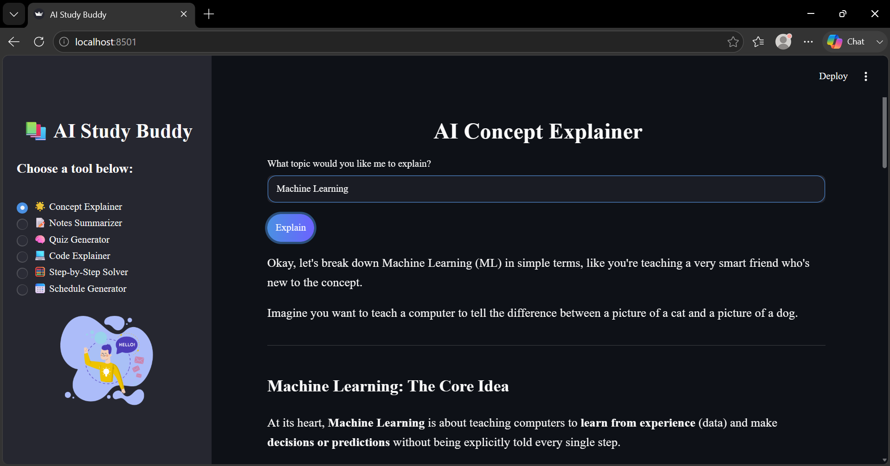
Some Output Samples

Slide 9
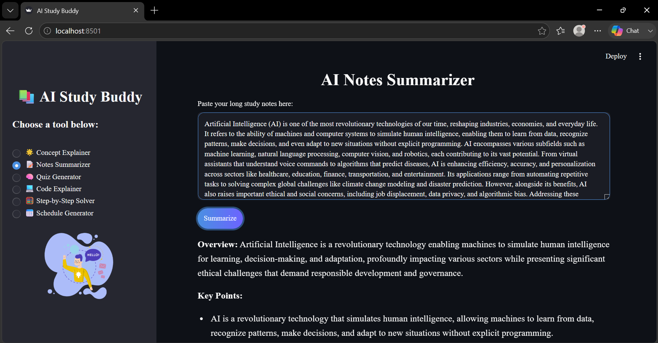

Slide 10
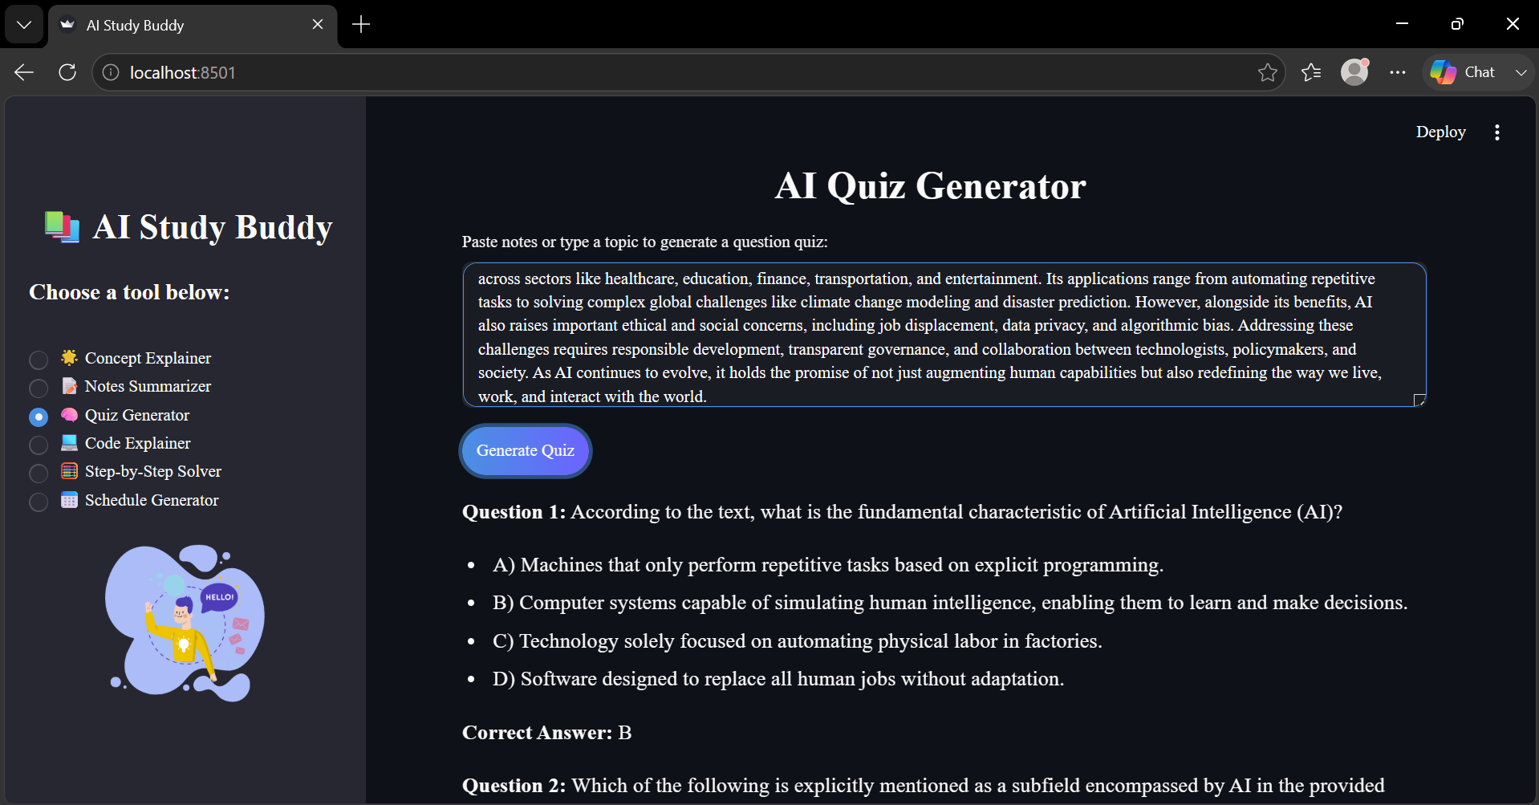

Slide 11
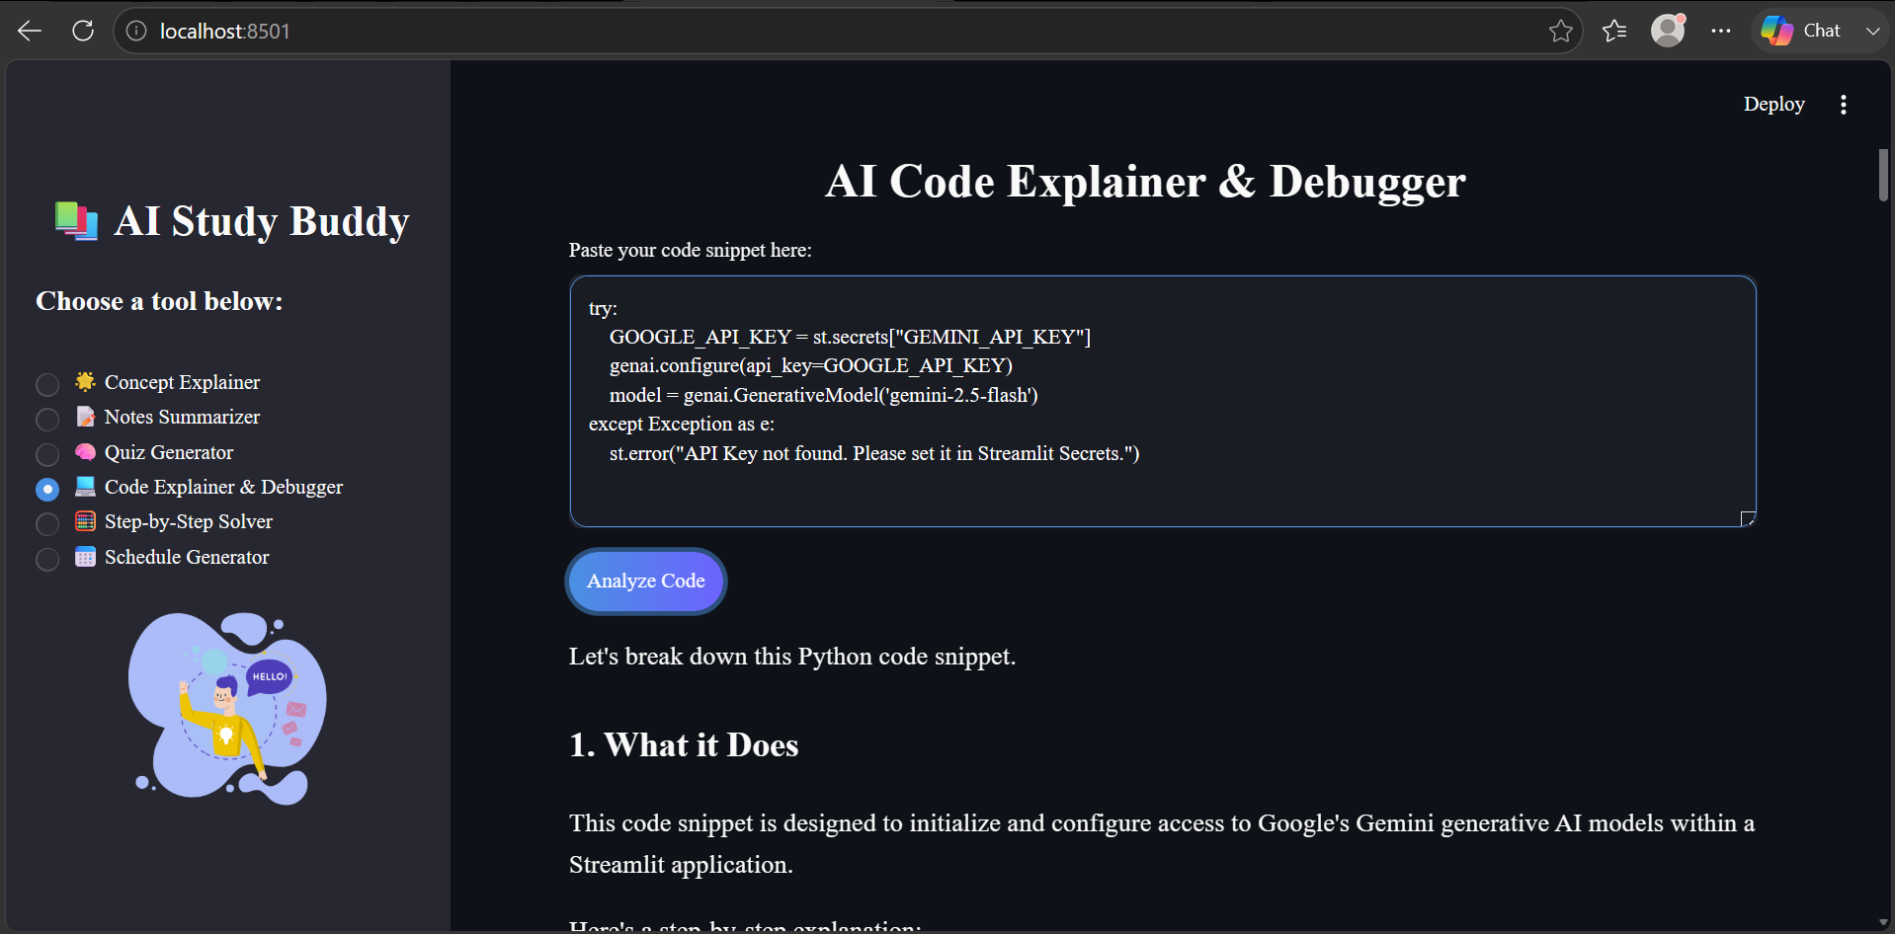

Slide 12
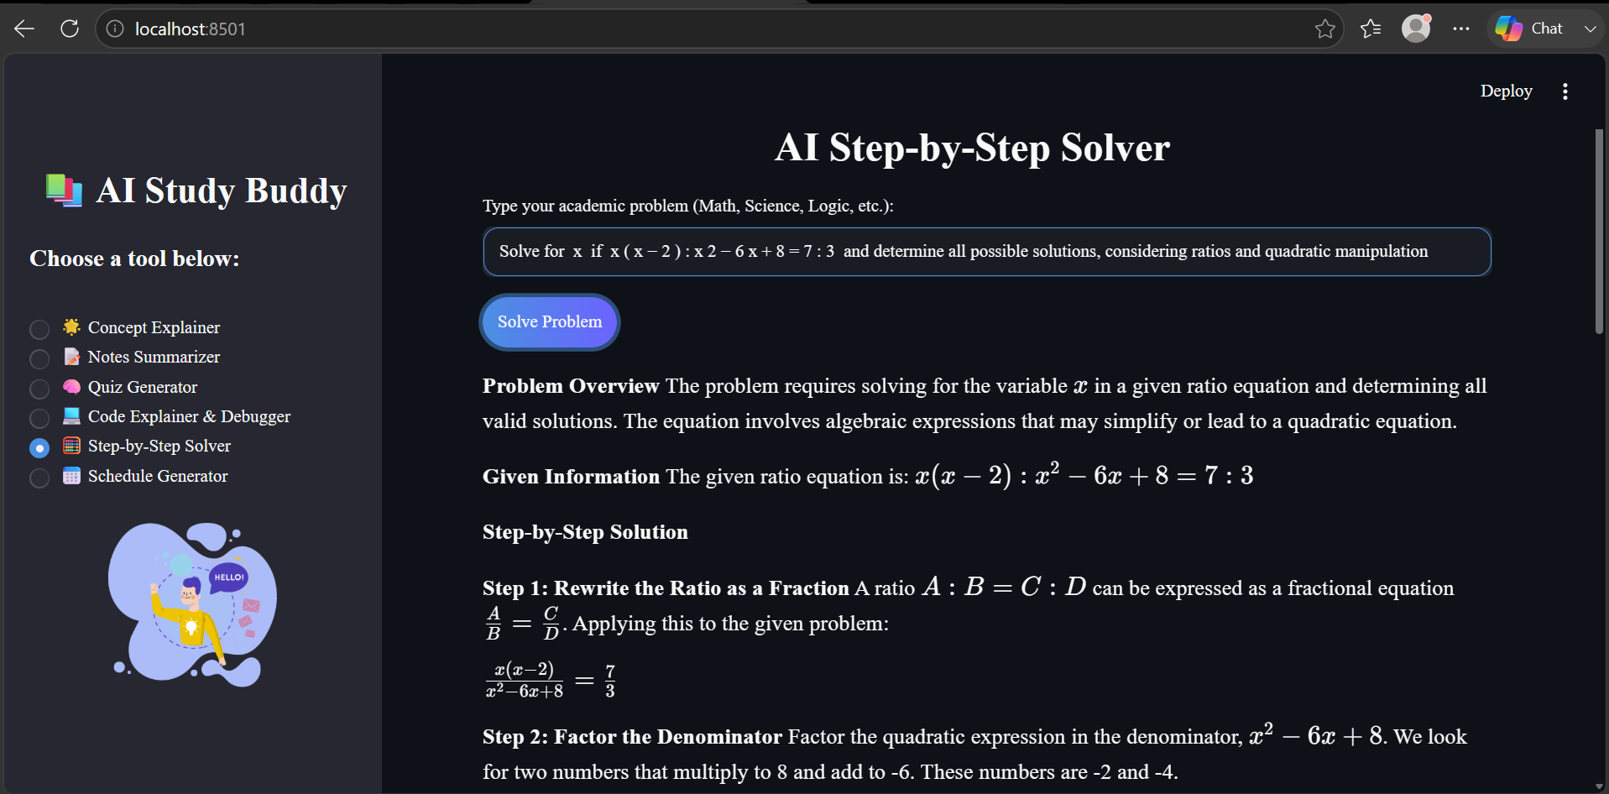

Slide 13
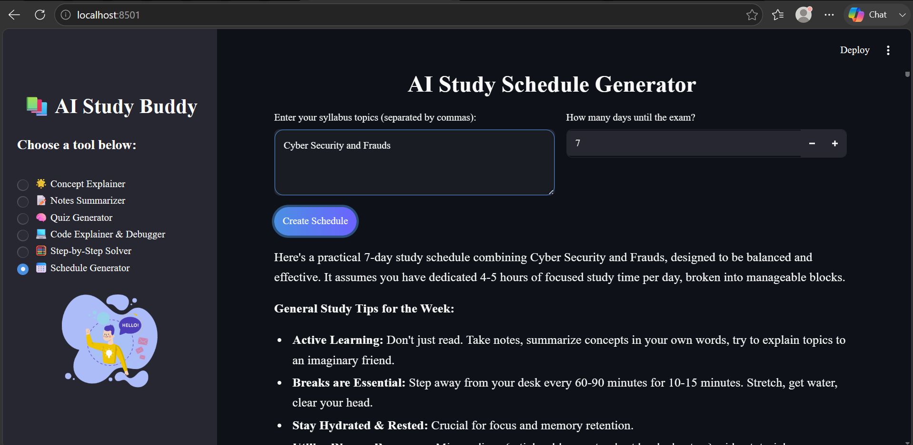

Slide 14
Conclusion
Our project proves that Artificial Intelligence can be used positively for active learning, not just for copying assignments or cheating.
It successfully acts as a personalized tutor that is available at midnight before an exam when teachers are not around.
By automating tasks like summarizing and scheduling, it saves hours of preparation time, allowing students to focus purely on understanding the core concepts.
Building this Capstone project gave us practical, hands-on experience with API integration, cloud deployment, and Python web development.

Slide 15
Future scope
PDF & Image Upload: Add a feature to upload PDF files or photos of textbook pages so students don't have to manually type or copy-paste long texts.
User Accounts & Database: Connect the app to a database (like Firebase) to add a login system, allowing students to save their past quizzes and study schedules.
Voice Input (Speech-to-Text): Add a microphone button so students can ask their doubts by speaking instead of typing.
Regional Languages: Translate the AI output into local languages like Hindi or Assamese so students from rural backgrounds can also benefit.

Slide 16
References
Python Official Documentation:- Used to understand core programming concepts and error handling.
Streamlit Documentation (docs.streamlit.io):- Used to learn how to build the user interface, buttons, and text areas.
Google Generative AI Guide:- Used to understand how to securely connect and fetch answers from the Gemini API.
Edunet Foundation:- The learning plan through ibm skill build platform and technical sessions are helped me to build my project.

Slide 17
Github link
GitHub Link : NeerajChoudhary2005/AI_STUDY_BUDDY_PROJECT: Completed core backend logic with all 6 AI Study Buddy features
Deployment Link: AI Study Buddy · Streamlit

Slide 18
THANK YOU

